Slide 1
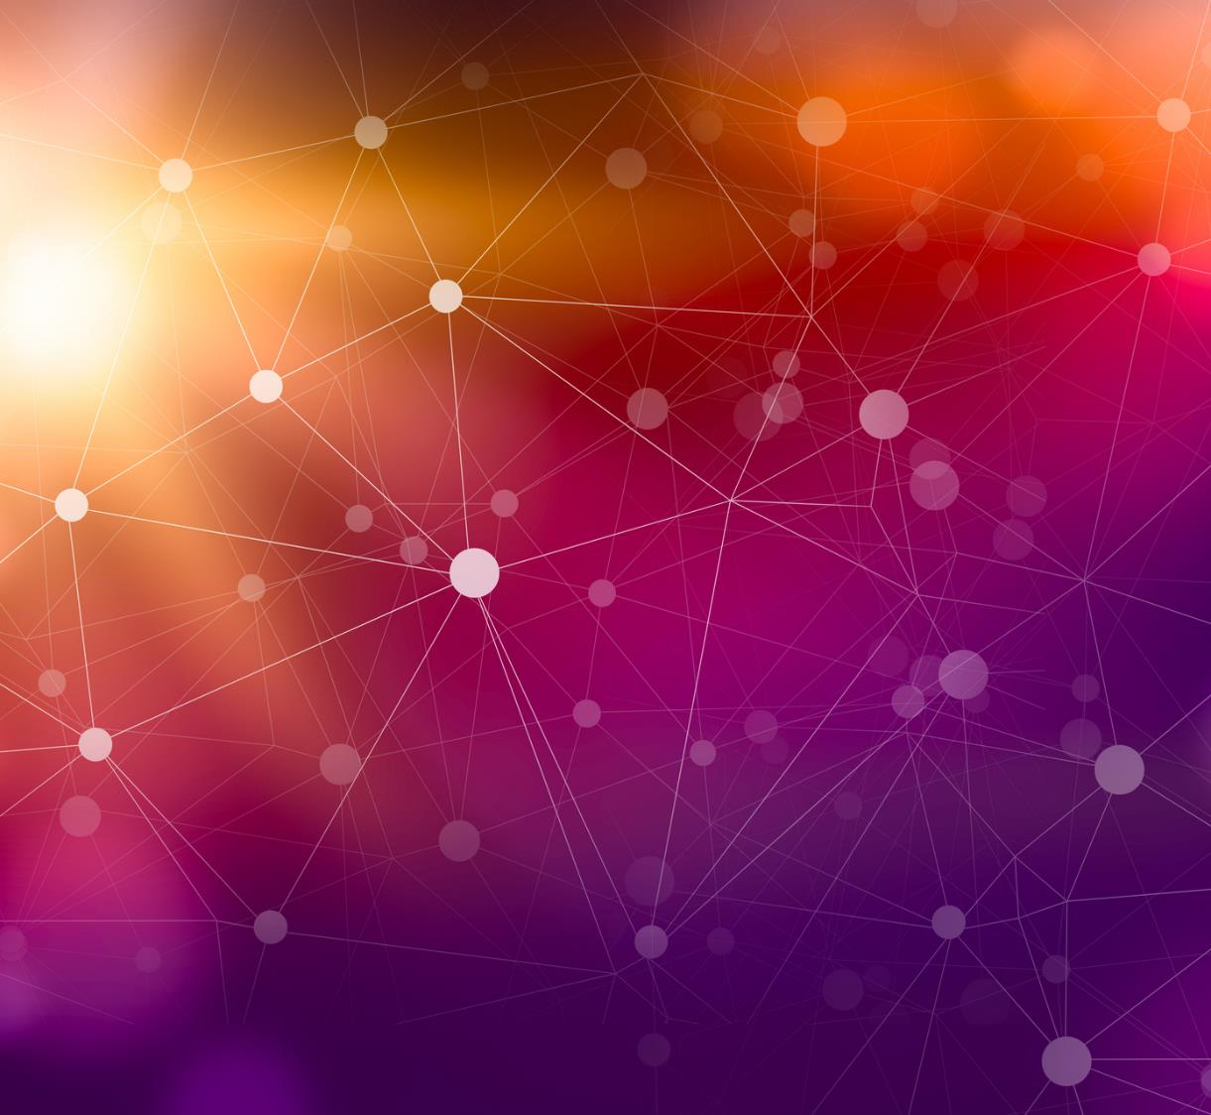
Intro to AI Project Proposal
Topic: Heart disease prediction analysis and detection using Neural Networks
Presented by:
Abhinav Andrews Giduturi
Student ID: 00744111
Nishanth Reddy Gangumalla
Student ID: 00726923

Slide 2

Heart disease prediction analysis and detection using Neural Networks
This study will concentrate on employing neural networks to forecast cardiac disease. Patients will be categorized according to different degrees of coronary artery disease based on characteristics including blood pressure, cholesterol levels, heart rate, and other distinguishing characteristics.

Slide 3
Project Objectives
The main objective of this project is to determine whether a comprehensive set of current parameters, such as blood pressure, cholesterol levels, heart rate, personality, weight, excessive perspiration, nighttime blood pressure, and other factors, can accurately identify people who would experience cardiac heart attacks. The UCI Machine Learning Repository will provide a dataset of 303 patients for this study. It should estimate whereas if person could undergo a heart attack using the same knowledge. Regardless as well as not, they include a biostability.
.

Slide 4
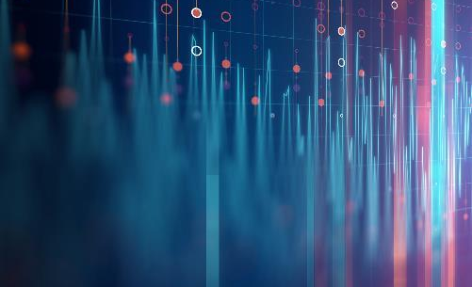

APPROACH
Some popular Python libraries, including pandas, numpy, and matplotlib, will be used in this project. Additionally, we will use sklearn and keras for this project's machine learning component.
The steps that are to be followed are:
Identifying and importing the dataset.
Designed and creating training and testing datasets.
Building and training the neural network.
Analyzing and improving the obtained results.

Slide 5
Deliverables
A .py jupyter file with the code and analysis.
Graphs and Histograms of data and model accuracy analysis.
Upload code into Github repository.
Upload video demonstration to youtube.

Slide 6
Evaluation
The success of this project can be analyzed by seeing the accuracy of the results not only with the trained dataset but also with test dataset and see the performance metrics using Sklearn.
Accuracy in representing the result data such as heart disease frequency for ages, cholesterol in graphs and histograms.

Slide 7
Thank You

